Slide 1
Reorganization Town Hall

Slide 2
Reorganization Agreement
Dorchester Minor Hockey Association, Aylmer Minor Hockey Association and Belmont Minor Hockey Association, are working towards an agreement on reorganization at the representative hockey level.
The agreement will require final approval from OMHA
Representative hockey to be operated under a reorganized rep hockey association
Each individual association will continue to operate separate local league organizations
Each association will need to hold a membership vote, date TBD (mid-April)

Slide 3
Reorganization Means:
preserving the hometown hockey experience at the local league level, while strengthening the competitiveness of our rep level teams for those who wish to play at that level.
players will play at a level that is appropriate to their level of skill and capabilities.
increased ability for organization to host specialized development clinics (e.g.: goalie clinics, power skating, skills and drills).
increase the depth of our coaches/bench staff to provide rep level players with the best coaching and development opportunities

Slide 4
Reorganization Means (cont’d)
most importantly - children enjoying playing hockey with peers while learning and developing at an appropriate level.
increased ice availability across multiple facilities to allow for additional practice times for both rep and local league teams

Slide 5
Reasons for Reorganization
OMHA and OHF have altered the hockey landscape to cater to higher caliber hockey
Very few rep centres in the surrounding area will be categorized as below ‘A’ beginning for the 2025-2026 season, with most ‘A’ centres competing with amalgamated or reorganized programs.
NRPs from Aylmer and Belmont can currently choose to tryout for rep programming with South Oxford or St. Thomas, but reorganization would force those top players to play for the DMHA/AMHA/BMHA reorganized program, increasing competitiveness of rep teams
Additional ice rinks to access

Slide 6
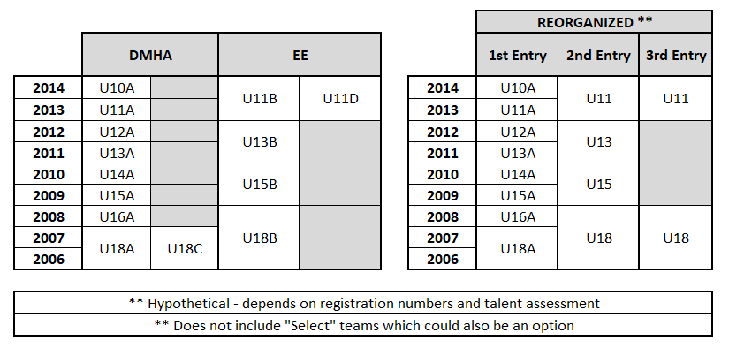
Potential Representative Teams

Slide 7
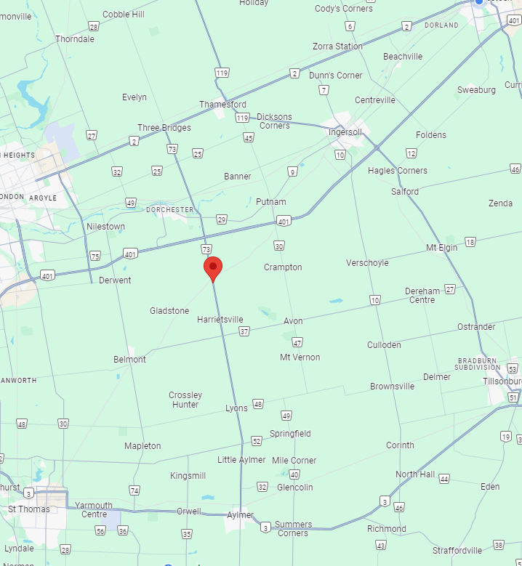
Right of Choice
All current DMHA, BMHA and AMHA families within the current residential boundaries for rep-level hockey will be permitted to continue (grandfathered) with the reorganized rep centre, despite changes in centre point
The reorganized centre’s centre point is planned to be 42.934727, -81.008781 (Highway 73 and Crampton Drive), Thames Centre (pending OMHA approval)
To calculate Right of Choice: 1) determined the distance between home address and the centre point 2) determine the distance between home address and alternate centre 3) if the difference between the two distances is less than 8kms, Right of Choice is granted to chosen centre

Slide 8
’A’ Classified Rep Centres changes made in recent years
Dorchester
Haldimand (Caledonia, Hagersville, Cayuga, Dunnville)
Mount Brydges
New Hamburg
Norfolk (Simcoe, Port Dover, Waterford)
St. Mary’s
St. Thomas (existing, back in Shamrock 2024/2025)
South Oxford (Tillsonburg and Ingersoll)
Strathroy

Slide 9
Other Amalgamations / Reorganizations examples
Haldimand (Caledonia, Hagersville, Cayuga, Dunnville) - COMPLETE
Norfolk (Simcoe, Port Dover, Waterford) – COMPLETE
Norfolk and Six Nations - APPROVED FOR 2024-25 SEASON (Temporary)
South Oxford (Tillsonburg and Ingersoll) – COMPLETE
North Middlesex, Lucan and Ilderton – IN NEGOTIATIONS
Brant County Minor Hockey Association (Paris, Burford, St. George) – APPROVED FOR 2024-25 SEASON
Norwich and Delhi – IN NEGOTIATIONS
South Point and Essex – COMPLETE

Slide 10
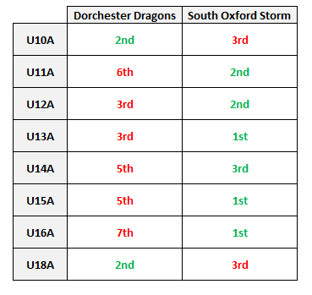
DMHA Compared Against South Oxford (Amalgamated Centre)

Slide 11
Next Steps
continue reorganization discussions to reach a reorganization agreement
await approval from OMHA for center point location ( GPS coordinates 42.934727, -81.008781 Thames Centre, ON)
host Town Hall information sessions to engage each associations membership
select a name, colors and logo for the new representative association
approve reorganization agreement by each individual board
membership vote (2/3 support vote required to proceed)
approval from OMHA of the official agreement

