Slide 1
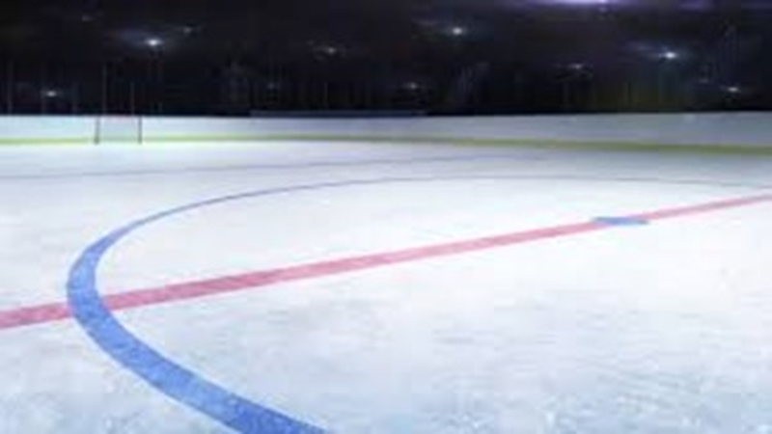
Partnership Townhall

Slide 2
A Minor Hockey Partnership Model Unique to East Elgin
This process began approximately 6 months ago with high level discussions between the two associations
Mutual challenges being faced as small centres and how we could better help each other
Wanted to explore flexible options that would allow us to keep the best of what we now have in terms of the Hometown Hockey experience
Maintain community spirit, while cooperating at a higher level to benefit the Rep Program where both center's have future potential to struggle
Led us to develop a Partnership Model that would result in both AMHA and BMHA to remain as Local League Centres
Create a New Rep Program to be run jointly by both partners

Slide 3
How Did We Get Here?
Exploratory Discussions – over the past 6 months
Discussions with our OMHA advisors
Local board of Directors - permission to proceed
Research into other centers who have taken on the same process/ partnerships

Slide 4
The Big Picture…What is the Goal?
Preserve our Hometown Hockey Experience
Preserve the independence of local boards on local issues
Ensure Local League teams remain in local rinks
Harmonize programs
Create a New Rep Program that both local centers feed into that maintains the current standard of competitiveness
Secure borders with surrounding centers
Create a New Board structure with equal representation
Ensure the fair rotation of Executive positions
All Coaching Decisions- have equal balance on committees
Pre-negotiate key policies on Coaching Selection and Tryouts to ensure fairness and reduce friction points
Preserve current ice allocations for hockey development, Local League and Rep programs

Slide 5
Partnership Model Proposal
The existing Local Leagues will continue in the same form:
Provide fun, recreational hockey with focus on development for all players
Kids playing locally in their community rinks with their friends
Pride in “representing” their home communities
Streamlined roles and responsibilities for local organizations
Provide a legal mechanism for communities to elect their local Minor Hockey Directors and to engage local sponsors and volunteers
Provides independence for Local Associations to remain in control of local league decisions (coach selection, IP Programs, LMLL representation, fundraising, etc)

Slide 6
Partnership Model Proposed
The two Local League organizations will bind together with a clearly defined and written Partnership Agreement setting out the relationship between parties:
Clearly defines the rights, obligations and relationships between the 2 partners
Provides the legal platform to create a new jointly administered Minor Hockey Association covering boundaries that all LL programs would then flow into for Rep Hockey
Partnership Agreement

Slide 7
Partnership Model Proposed
Proposed Structure:
Local League organizations would transfer their OMHA Rep hockey rights, and all higher level hockey operational functions to the newly created Minor Hockey Organization to be run by the combined Board at the Partnership level
Elected Directors from the Local League level would flow upwards and represent their associations on the combined Board of the New Centre, providing equal representation from both associations
The newly created Minor Hockey organization will provide high level business services to the entire organization (e.g.: registration, Admin, OMHA representation, regulatory, player movement)

Slide 8
Partnership Model Proposed
Membership Rights:
Players and families will continue to be members of their existing Local Associations (AMHA, BMHA) based on the Bylaws and Constitutions of those organizations
Same membership rights and entitlements will continue
Members of the Local Associations will participate indirectly in the administration of the New Minor Hockey Organization by electing their Local Directors who serve as Delegates on the New Minor Hockey Board to represent them
Members are still entitled to attend All Membership meetings, be informed of association activities, ask questions and participate in meetings- the elected Delegates will represent their local community interests on the New Board as voting members

Slide 9
In Summary
Partnership Model is consistent with the history and traditions of the current Minor Hockey communities and promotes preserving the local identities of the Associations
Well-structured and stable model that will clearly define roles and responsibilities- easily manageable by both centers
Provides a flexible “win/win” for both Associations- leaves some independence at the Local League level, while allowing cooperation in areas where both centers have a high potential to struggle in the future
All Local League Centres keep their identity
Ensures both centers maintain a competitive, and robust Rep Program with local community support

Slide 10
Why Do We Need to Partner
Enrollment is stagnant or declining
St. Thomas, Dorchester, and Tillsonburg will all be “A” centers starting the 2024 season
All three centers will have the ability to draw AMHA/BMHA players (NRP)
Loses are expected
Allow us to continue to field competitive rep teams with players of similar ability
Continue to sustain strong local league programs

Slide 11
Risks of Not Partnering
May not be able to field competitive rep teams if we lose our higher caliber players to “A” centers
Eventually not being able to field rep teams at every age group
If there comes a time when we cannot field any rep teams we will lose our rep status with OMHA forever and become a local league only center – unable to support out competitive players
Wait and see stance may force Belmont to seek out a new partner with no option for Aylmer to amalgamate in the future

Slide 12
Frequently Asked Questions
What would our classification be under an amalgamated center?
Likely to be classified as B
Would the new association be able to offer a minor/major system?
Depending on enrollment and competitiveness there could be an opportunity to roster a “B” and “C” team.
Also opportunity to create Roster Select teams that combine LL players from Belmont and Aylmer
What would the new association be called?
No decision yet
If the vote comes back as “no” what happens?
Amalgamation does not proceed, no change to current

Slide 13
Frequently Asked Questions
Who can vote?
One vote per registered family. In the case of a split family, only one parent from the address on the registration form may vote
What will the center point be for the new center?
This is currently under negotiation
What arena will the rep teams play out of?
Currently the agreement is to work towards a fair and balanced allocation between the two arenas based on available ice
What league will the rep teams be playing in?
The current agreement proposes our rep teams play in the Shamrock League but this still requires approval from OMHA

Slide 14
Partnership Process Status
AMHA and BMHA boards approve moving forward with amalgamation discussion – complete
Inform OMHA of our intentions – complete
Town Hall meeting to provide information to membership – Feb 9
Both boards must approve the negotiated agreement – in process
Each association must hold a membership vote – tentatively 22-Feb
Approval by OMHA – March 2023

Slide 15
Questions?

